Slide 1

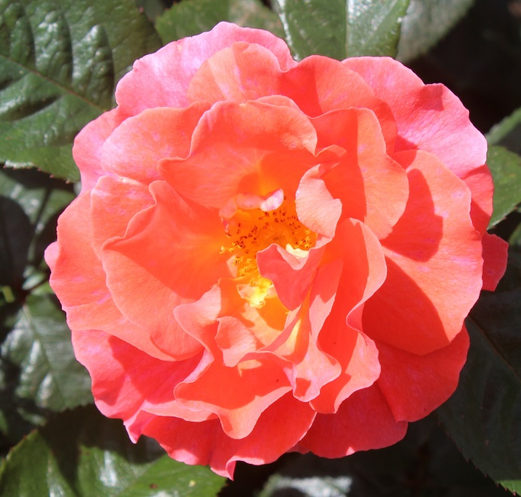
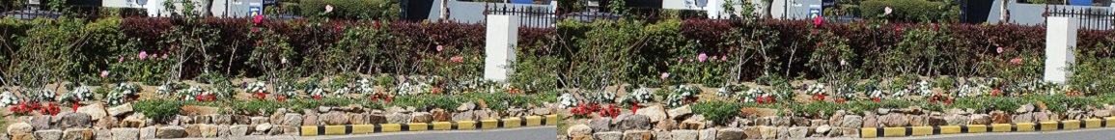
“Across the Ditch” Aotearoa New Zealand Rose Trip November 2017 John Keays

Slide 2
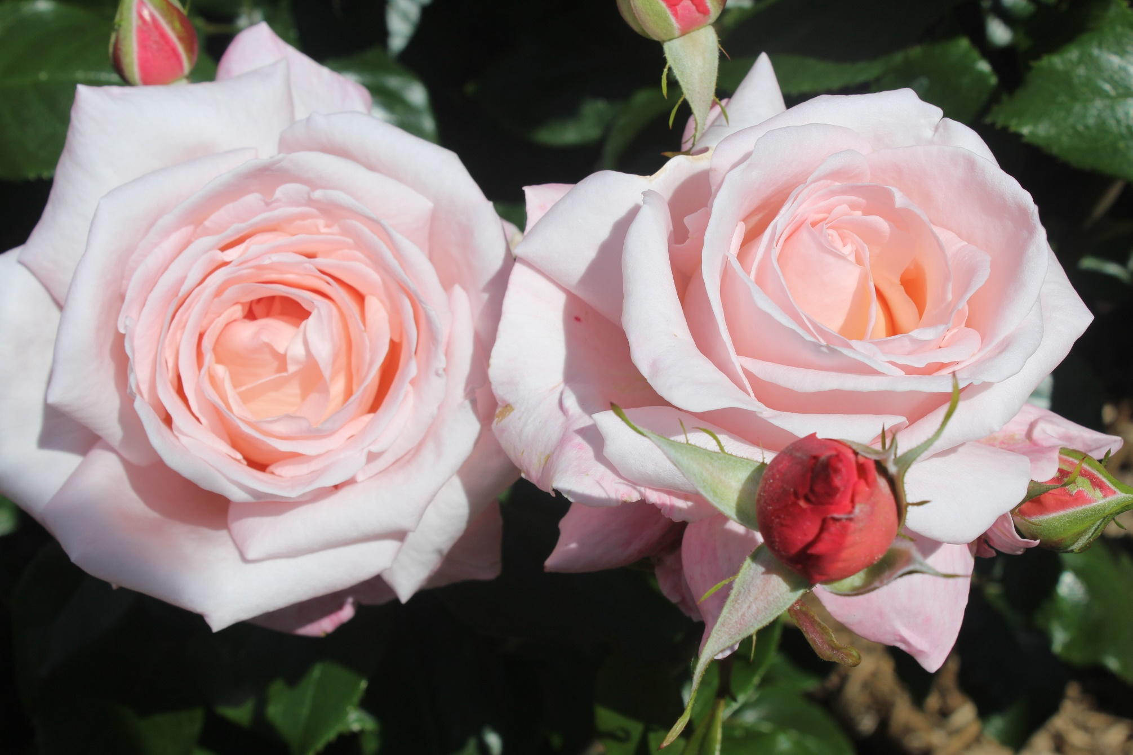
Aotearoa by Sam McGredy, Rogers Rose Garden

Slide 3
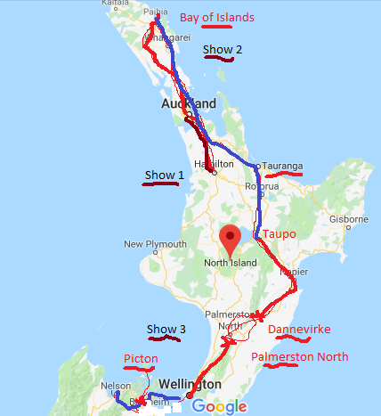
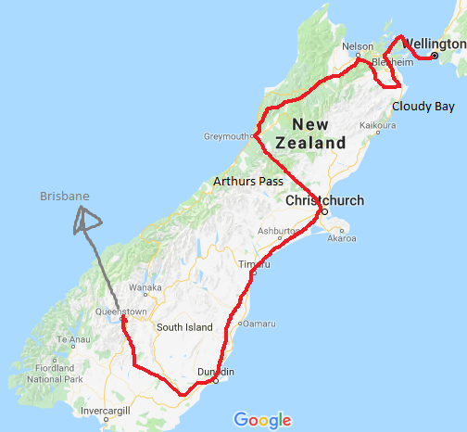
Map of New Zealand with route in Red

Slide 4
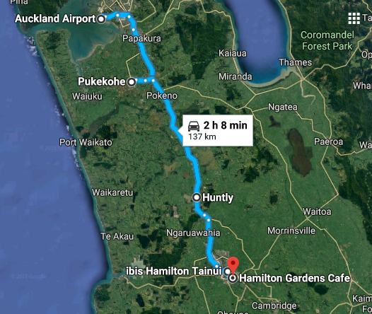
Auckland to Hamilton
Sues trip after Knee Surgery
Contacted NZ Rose Society
Found 3 Rose Shows
10th Nov, Hamilton
17th Nov Whangarei
24th Nov Palmerston North
Hayden Foulds, National
Paul McKeany,District
Doug Grant, President

Slide 5
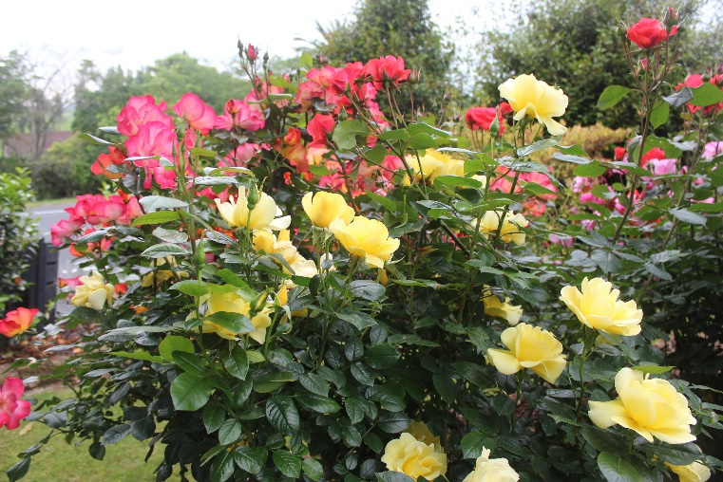
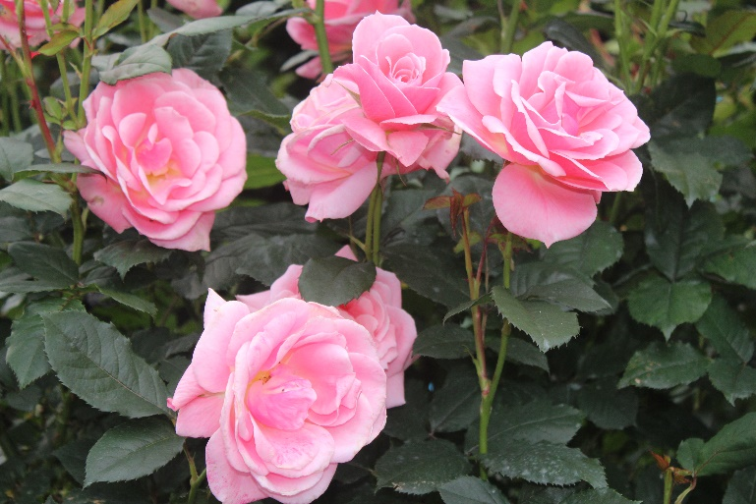
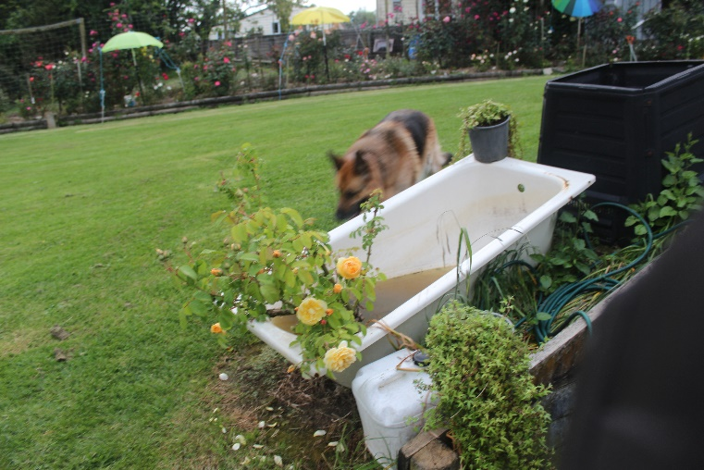
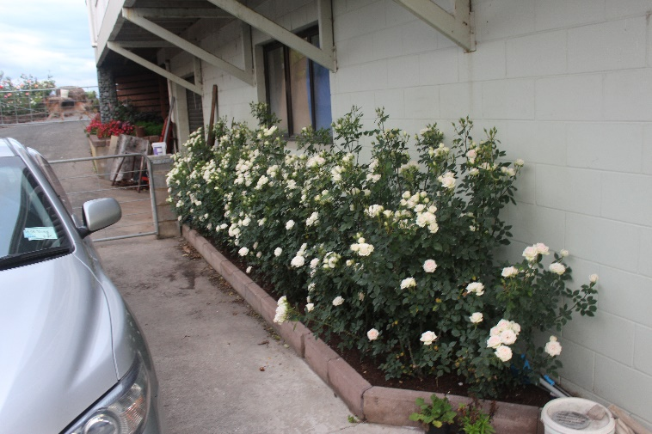
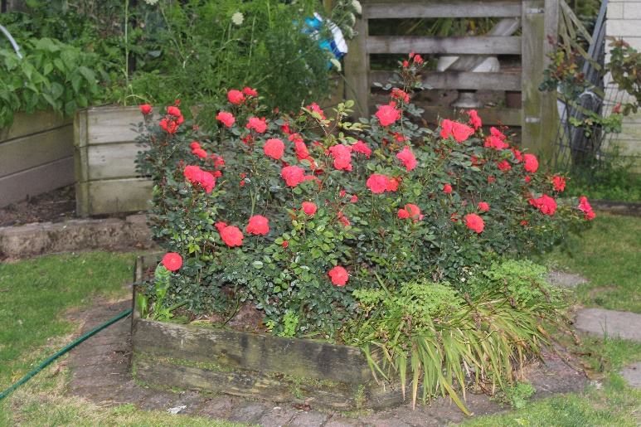
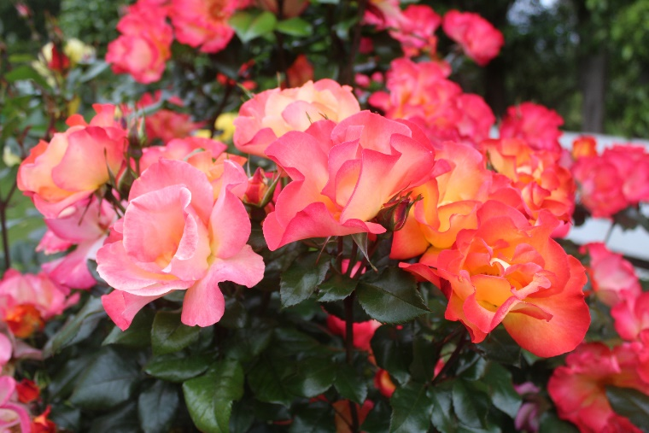
Our introduction to NZ Roses
Pamela Bartram
David Austins Graham Thomas
Irresistible

Slide 6
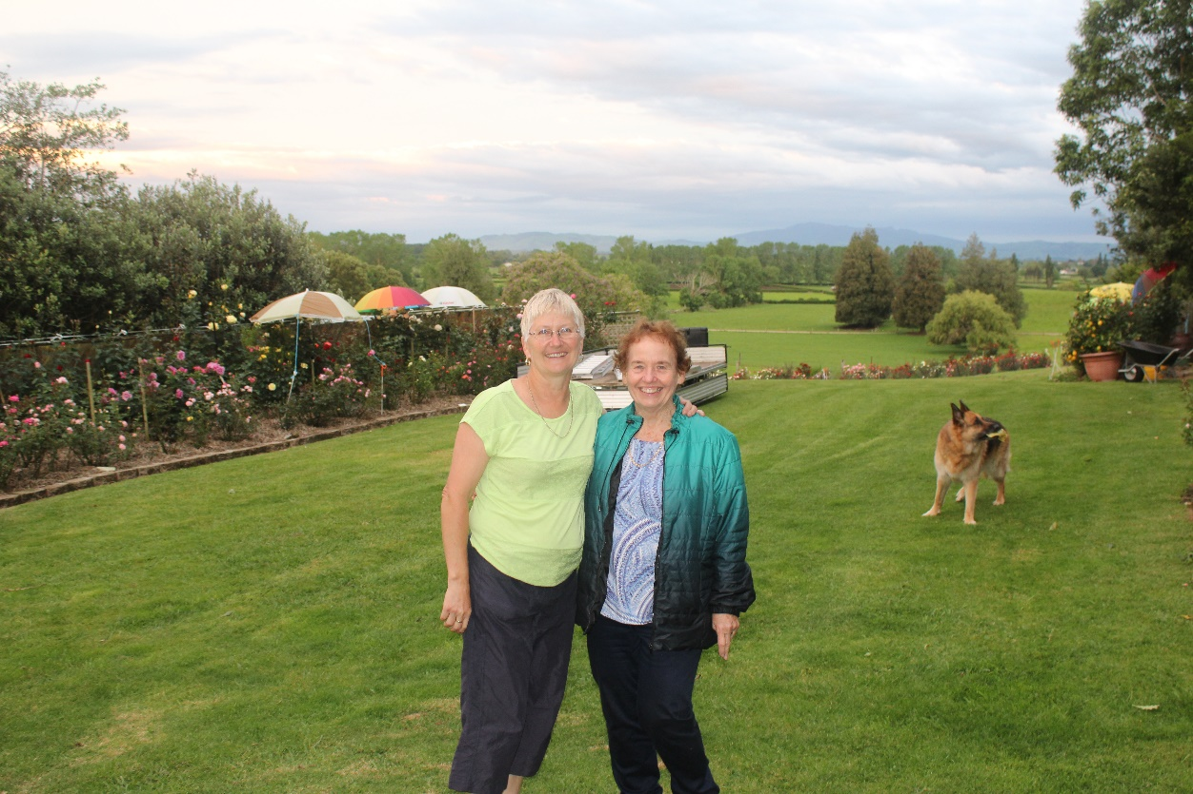
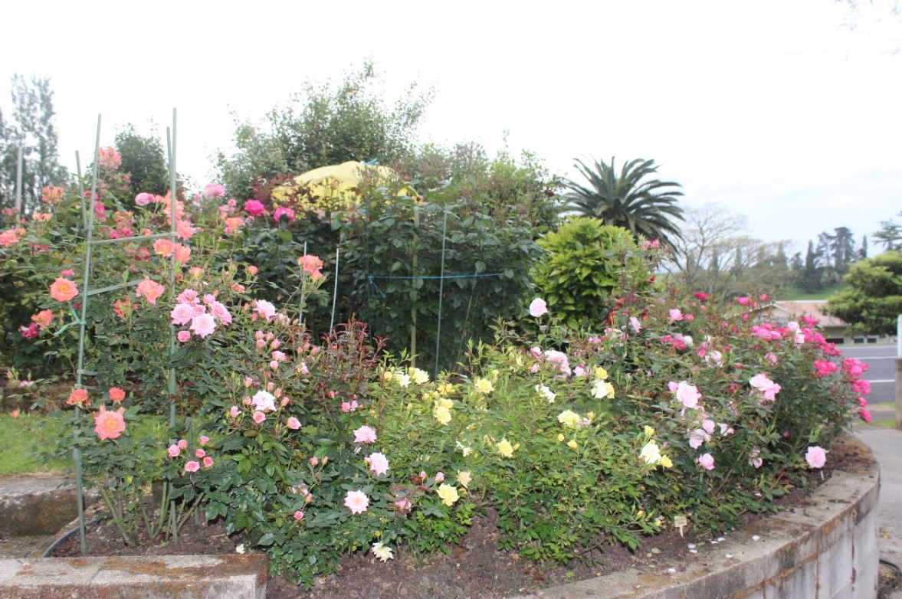
At Hamilton NZ. First to Sheree Gare’s garden
Sheree’s front Garden. Scooped the prize pool
Sheree, Sue and Dog Note umbrellas for roses

Slide 7
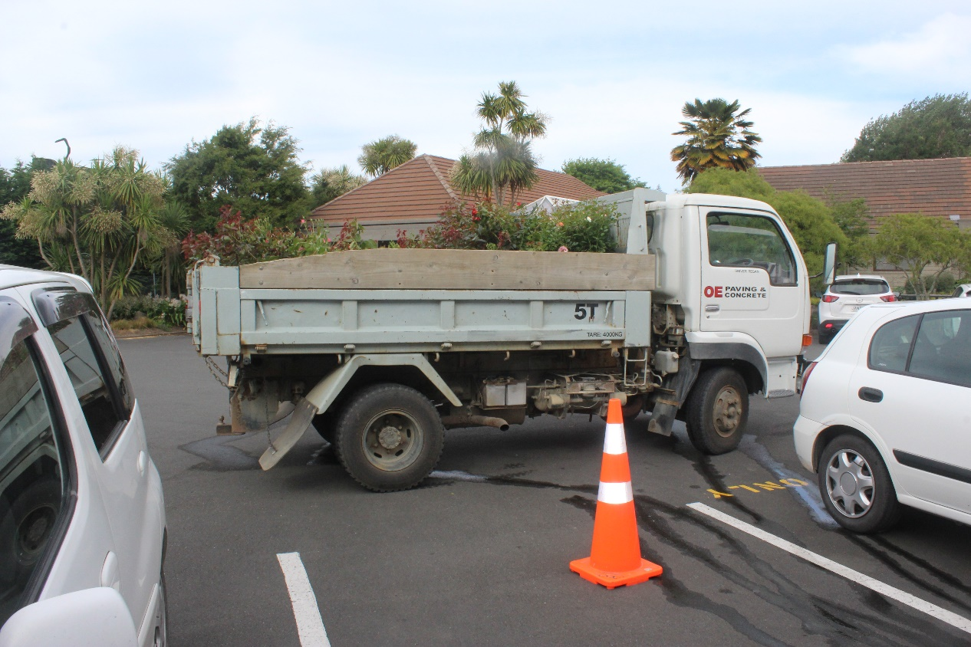
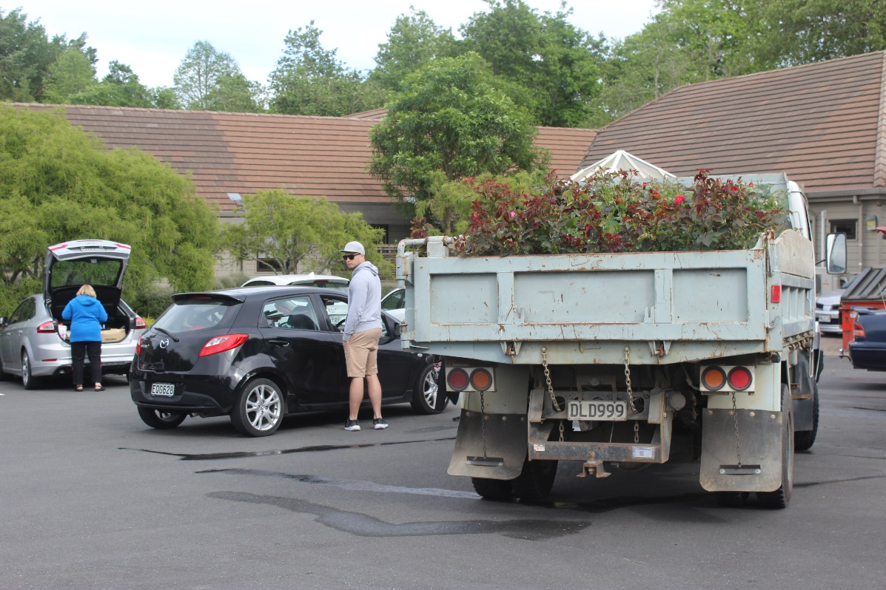
Daltons Waikato Rose Society Rose Show The Roses arriving at the Staging point Friday at Hamilton Gardens

Slide 8
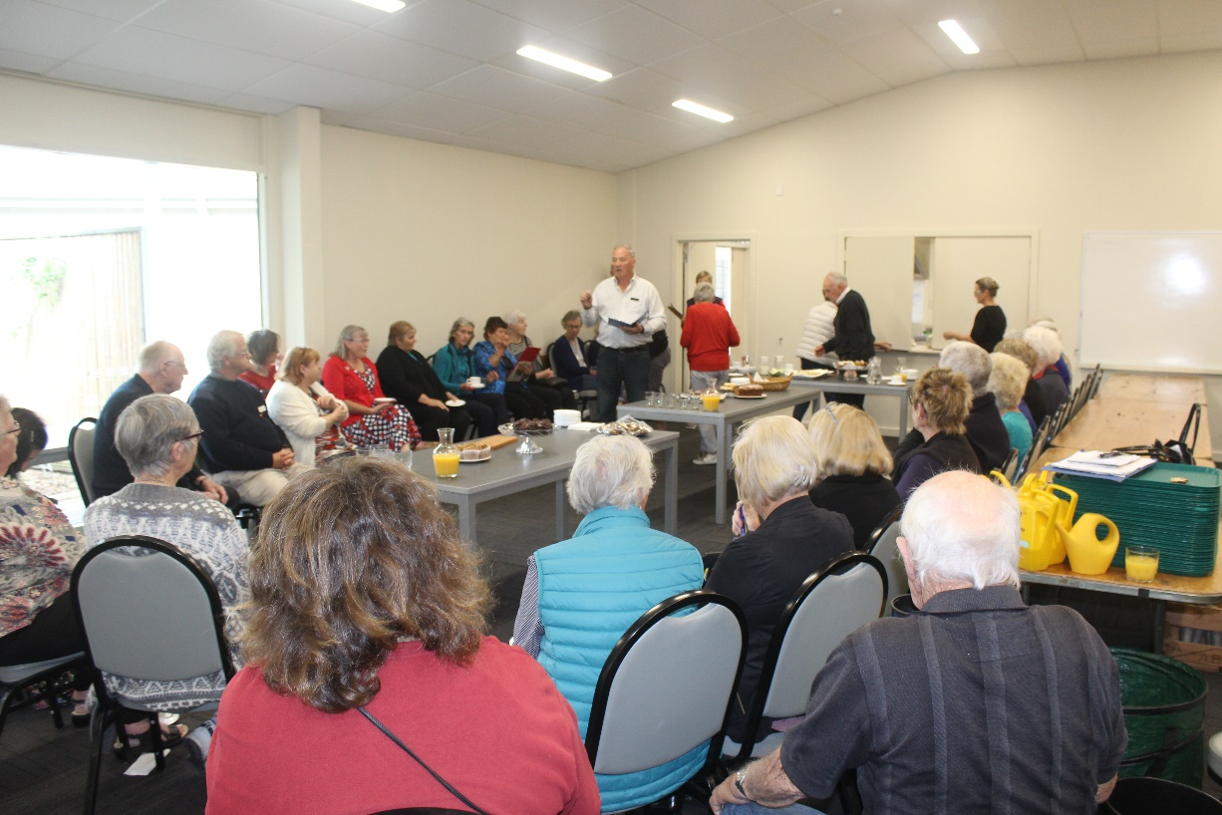
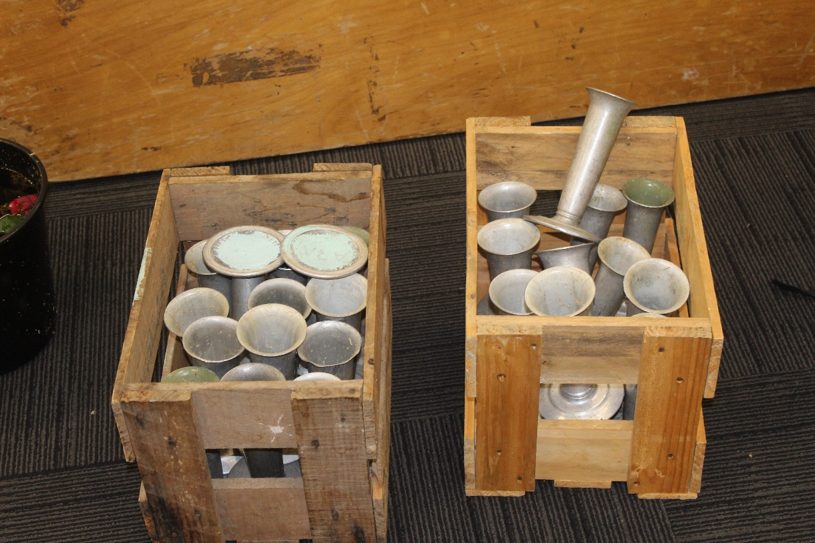
Preparation for Judging … no green bottles Briefing of exhibitors and judges

Slide 9
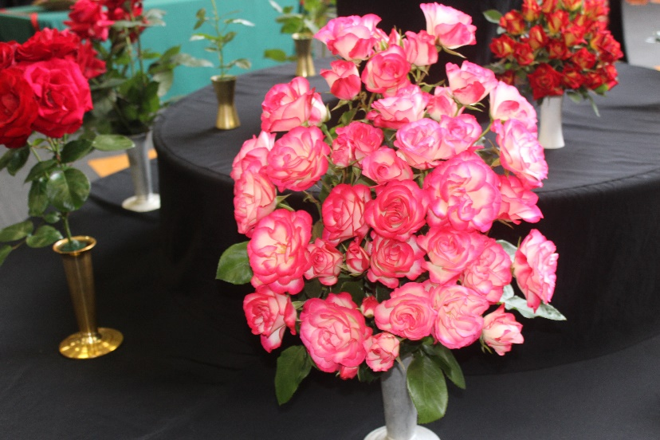
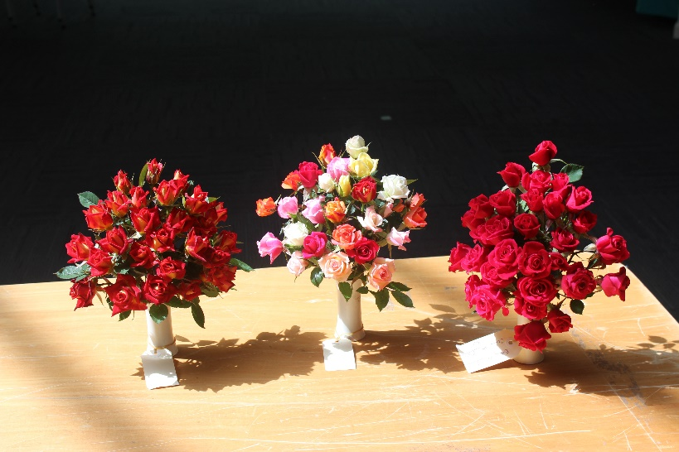
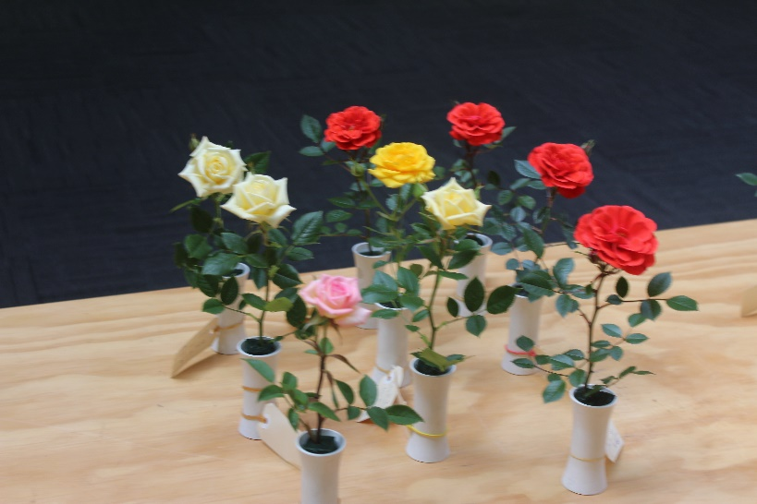
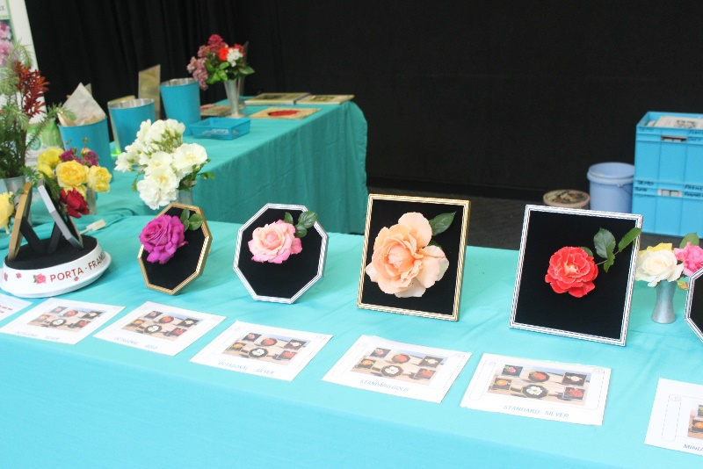
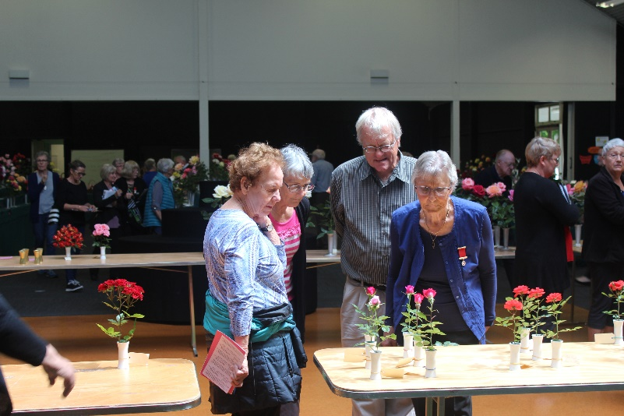
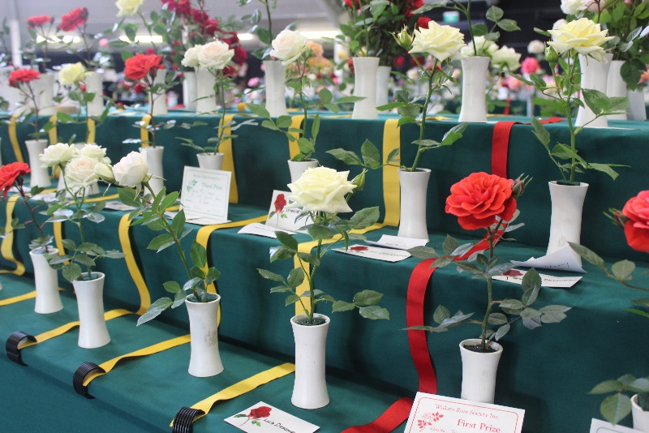
Judgement Day for the Rose Show, Hamilton Gardens

Slide 10
Rogers Rose Garden in Hamilton Gardens
The Pacific Rose Bowl Festival takes place every November in the Rogers Rose Garden, located in the beautiful Hamilton Rose. The four-day Festival is centered around the New Zealand Rose of the Year Trial.
The New Zealand Rose of the Year is one of only two Rose Trials in the Southern Hemisphere that are judged by public votes. There is also a Children’s Choice Award section.
The roses in the trial are clearly marked and all you have to do to be part of this wonderful event is to take a stroll amongst the gardens and select your favourite five roses.
The Hamilton Rose Trial Grounds are linked to Australian, Japanese and Californian trial grounds through a friendship agreement initiated by Dr Sam McGredy.
Recognized as a Garden of Excellence by WFRS

Slide 11
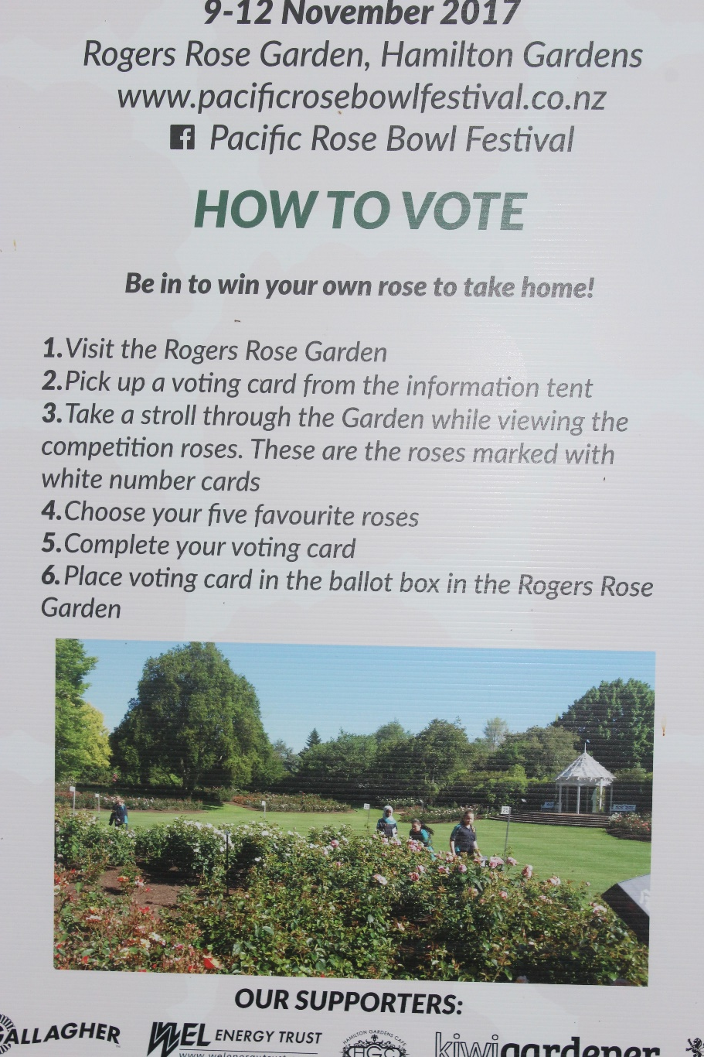
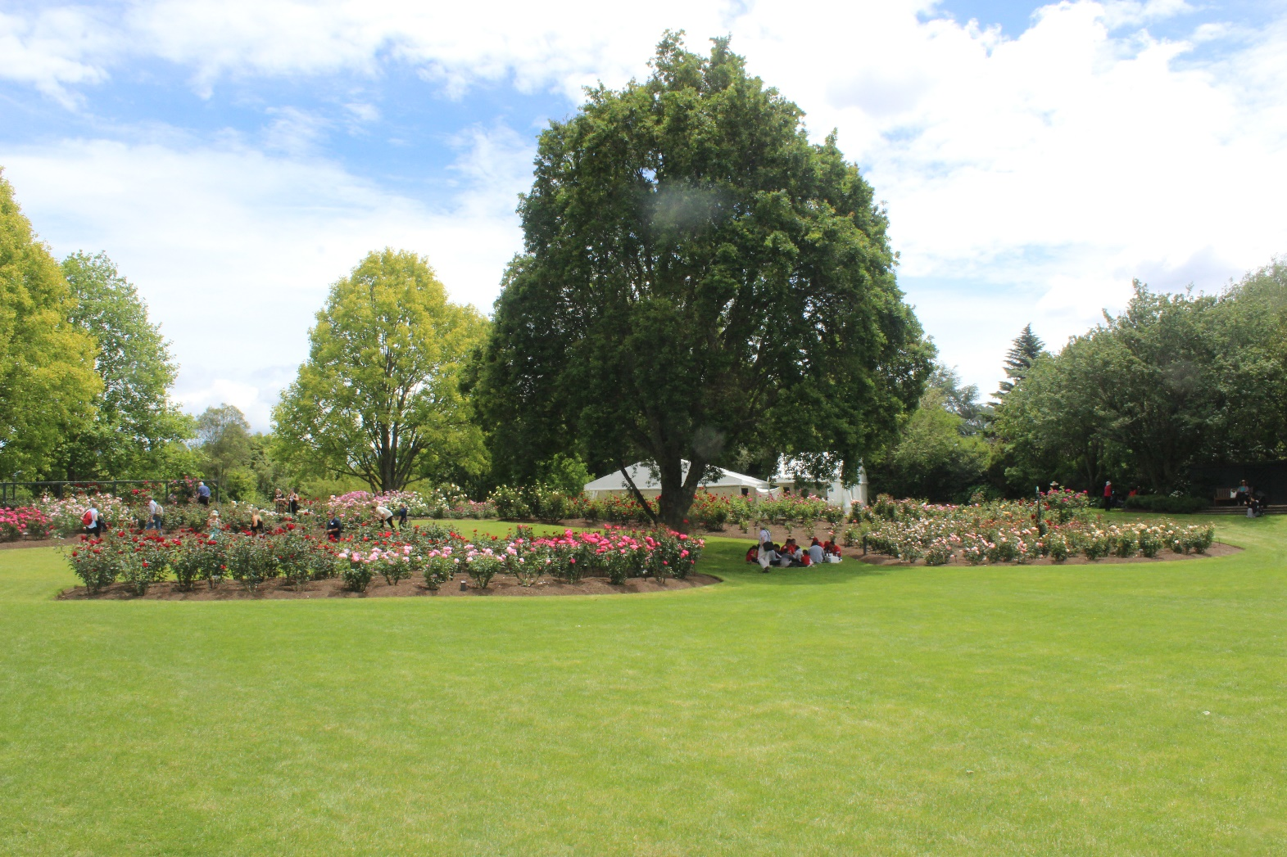
Public Involvement in Roses Rogers Rose Garden How to vote

Slide 12
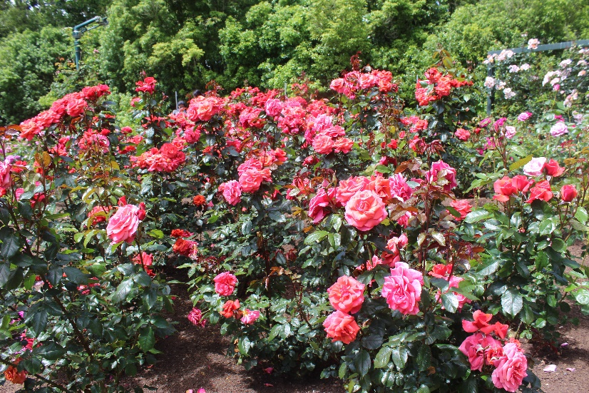
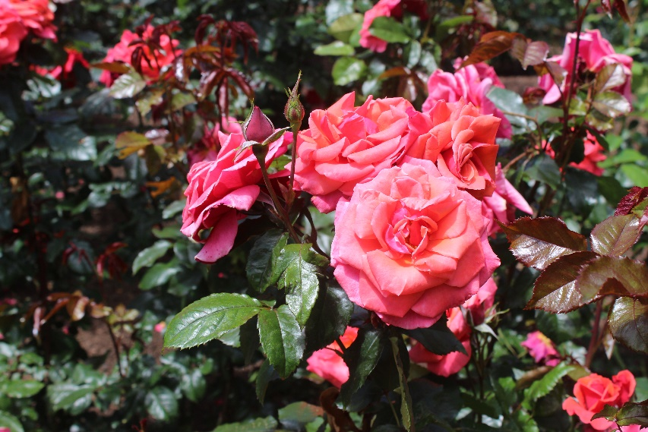
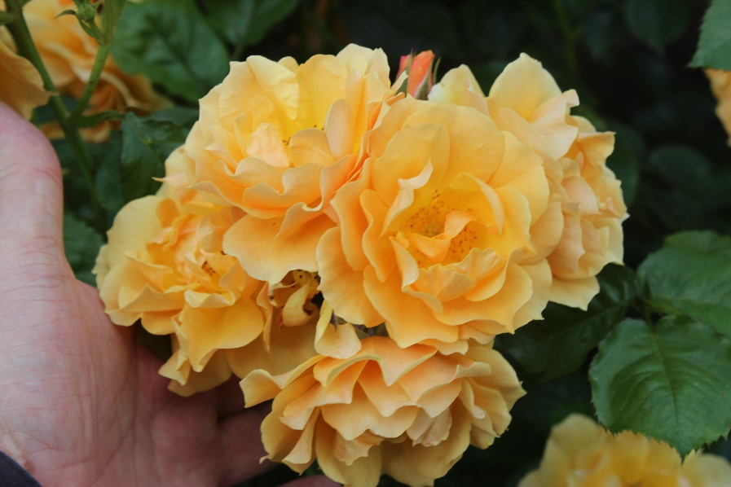
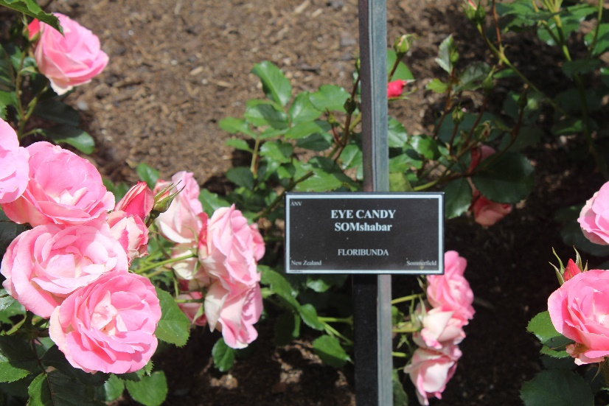
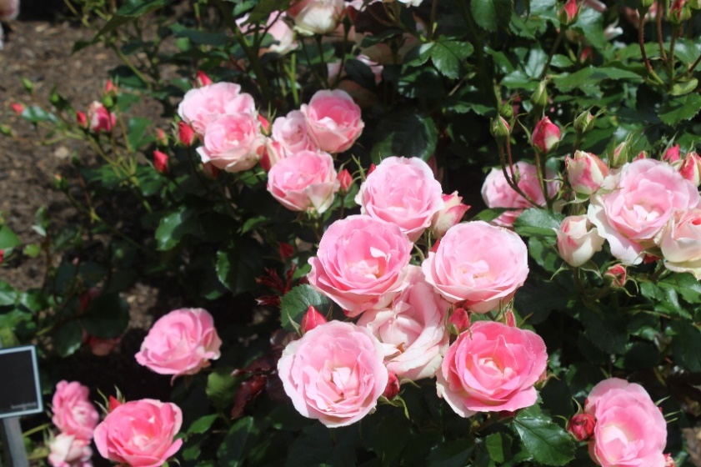
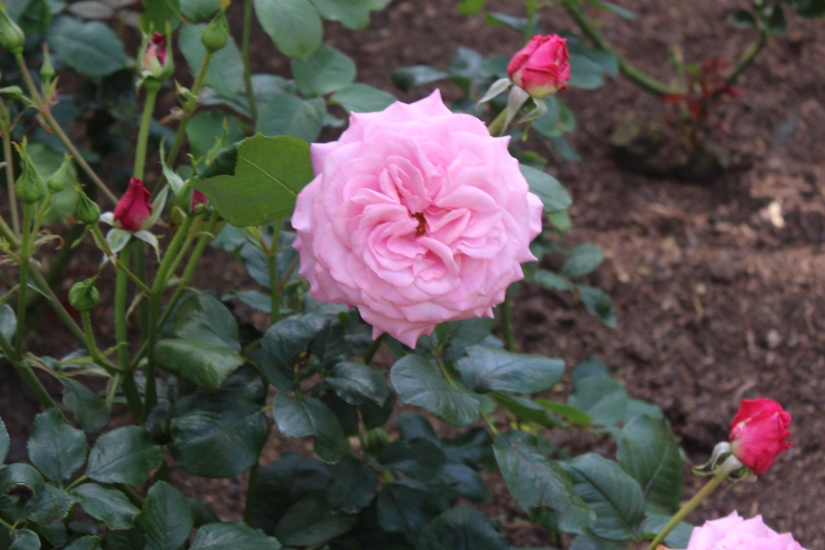
Top Shelf
Frilly Jilly
Eye Candy
My Girl .. McGredy

Slide 13
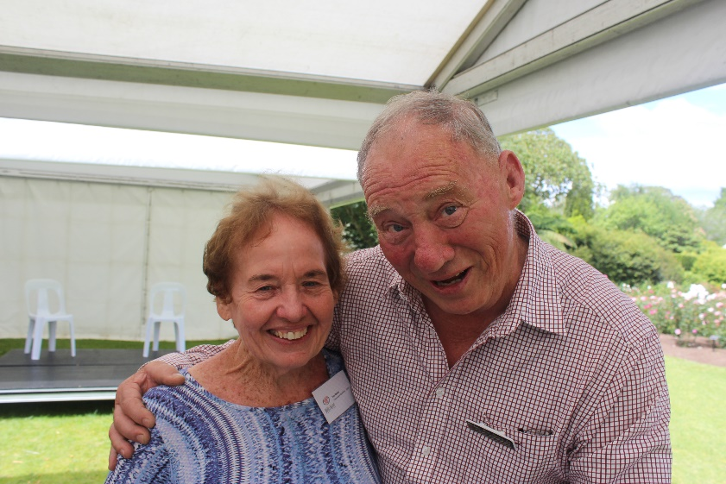
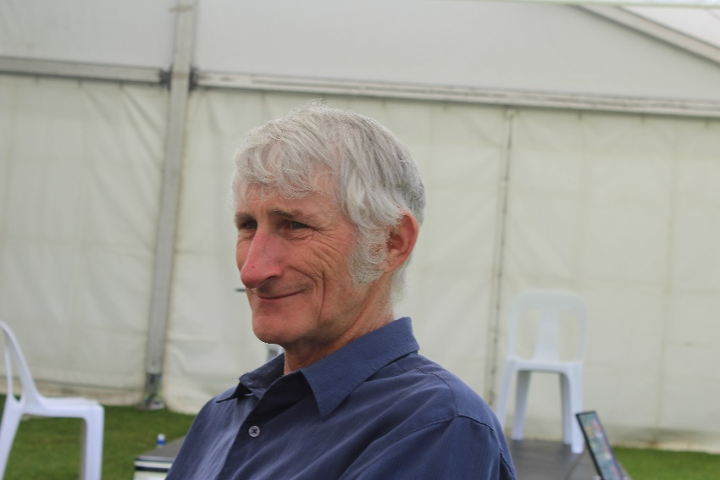
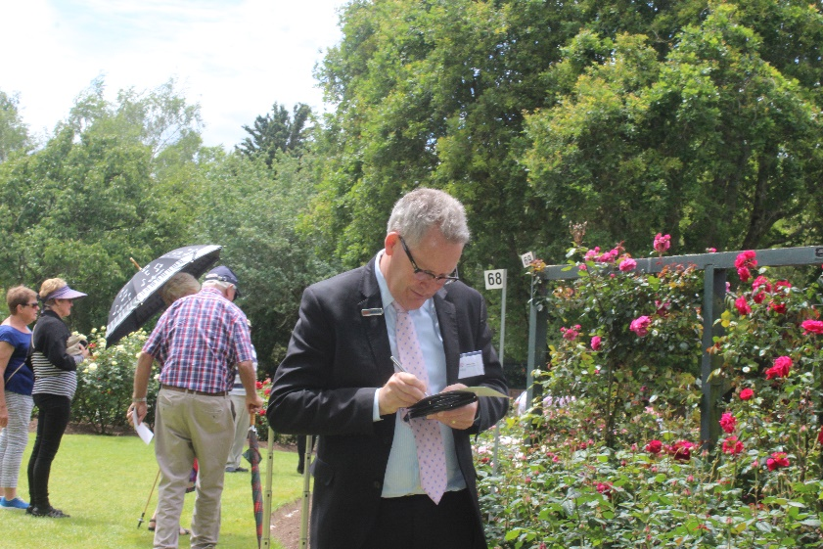
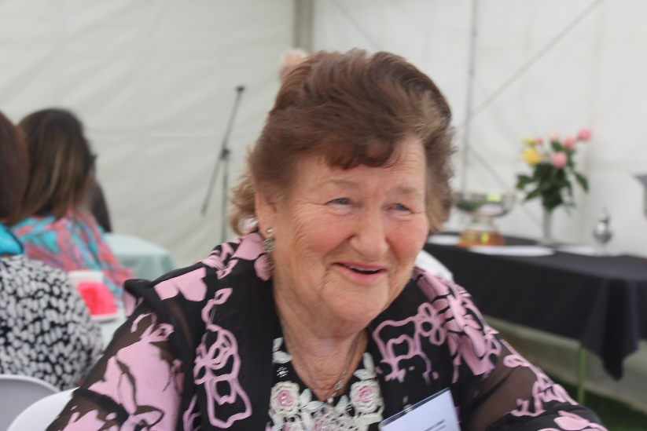
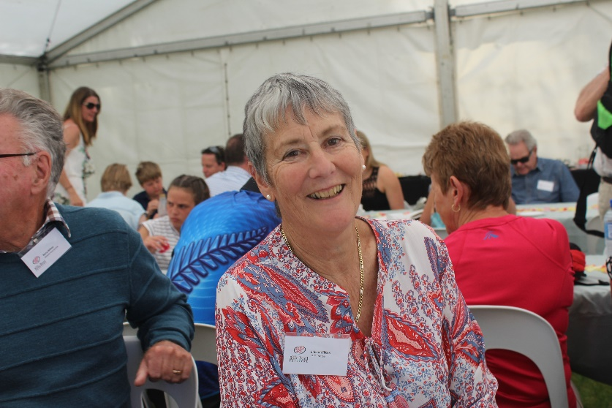
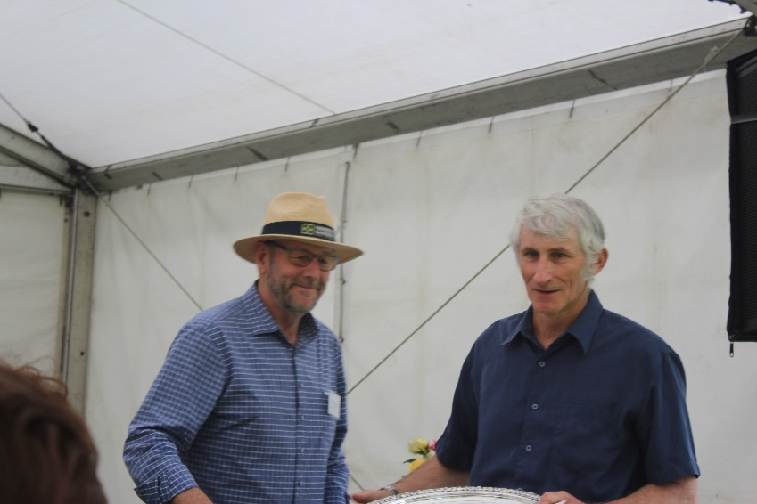
The Dignitaries in the Garden. President Paul McKeany with Sue and the Lord Mayor of Hamilton
Paul McKeany
Doug Grant
Mayor Andrew King voting
Peter Sergel with Doug Grant
Margaret Liddell
Eileen Wilcox

Slide 14
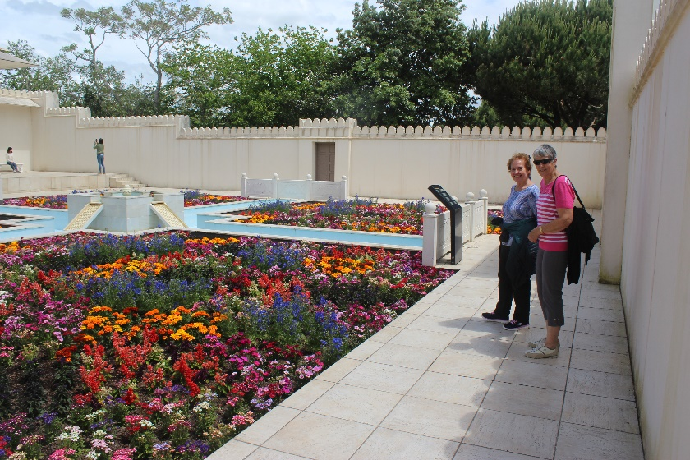
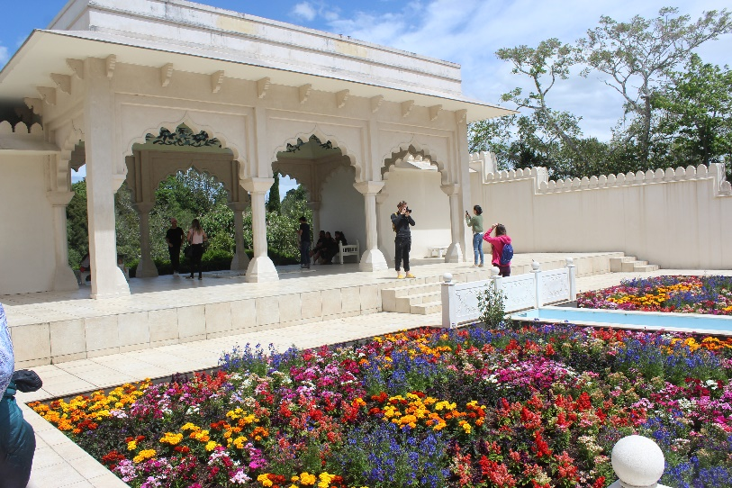
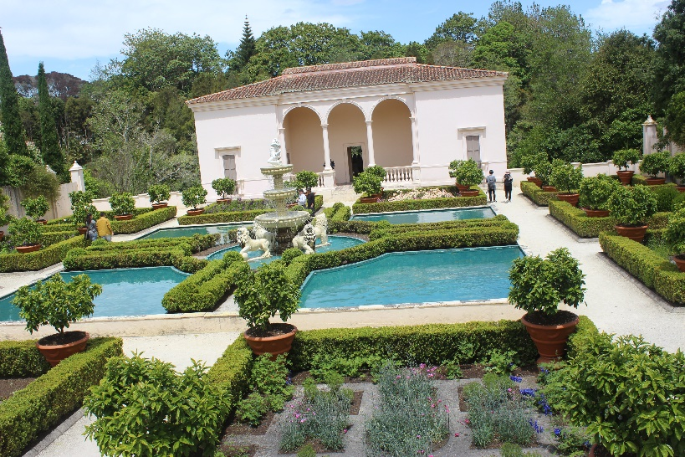
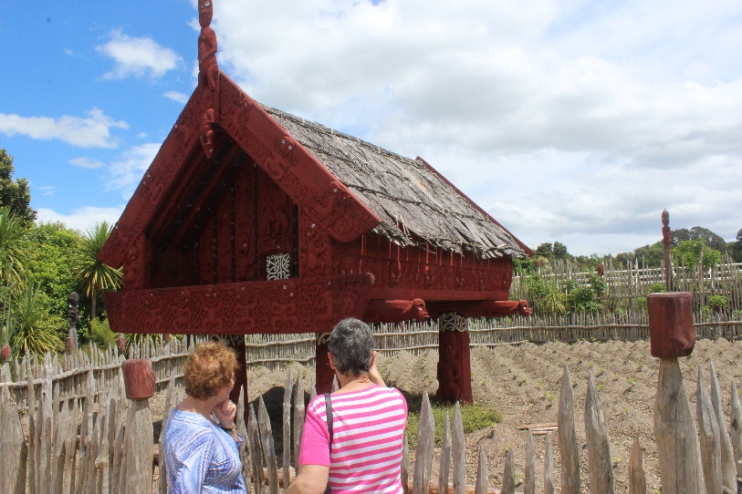
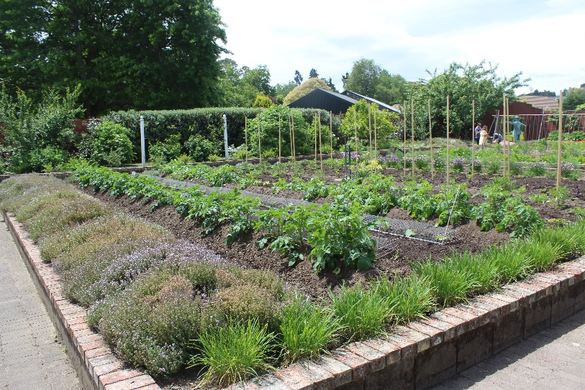
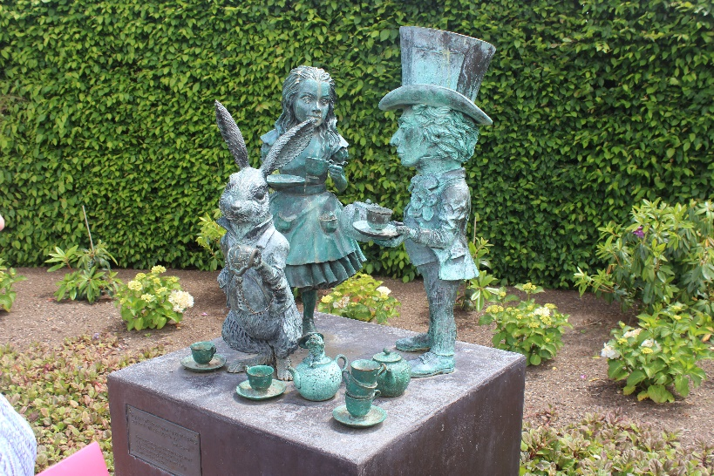
Hamilton Gardens: The old Rubbish Tip Converted to Lovely Green Space
Indian Room
Italian Room
Maori Room
Vegetable Garden
English Garden

Slide 15
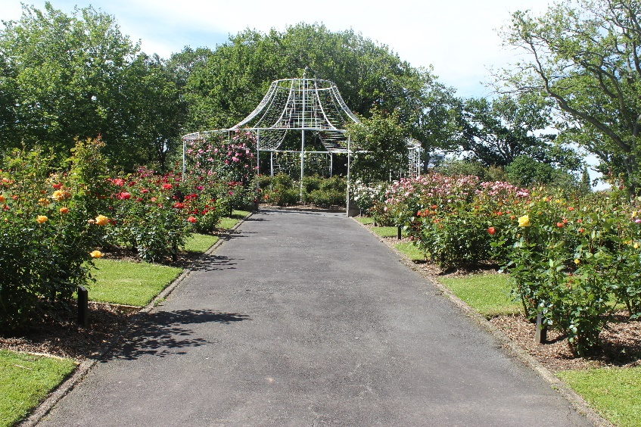
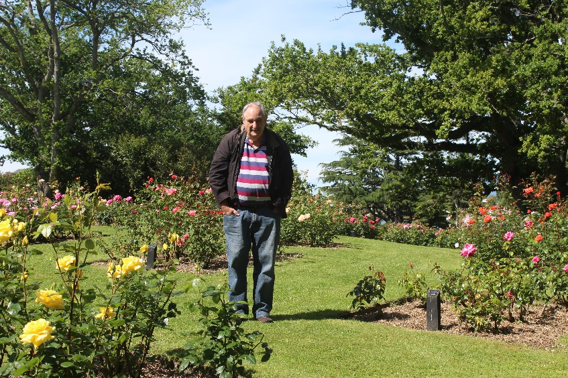
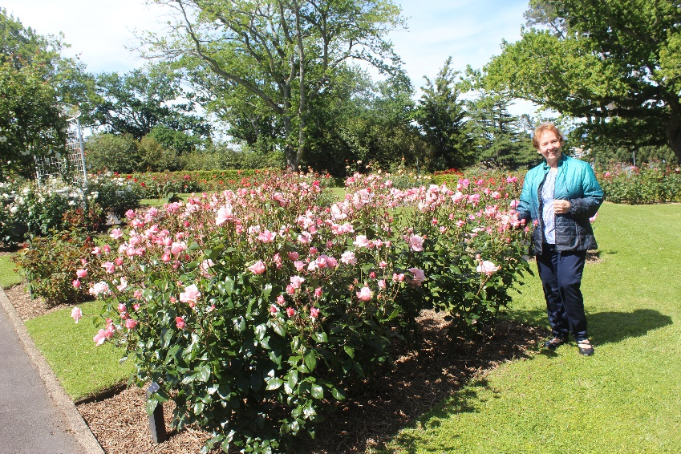

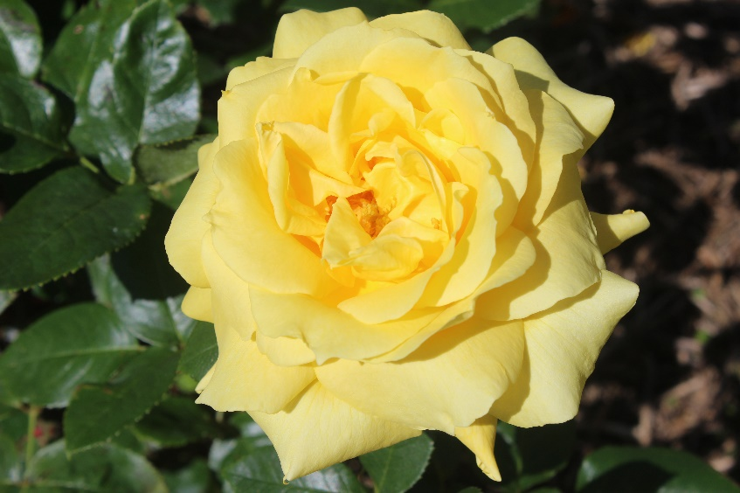
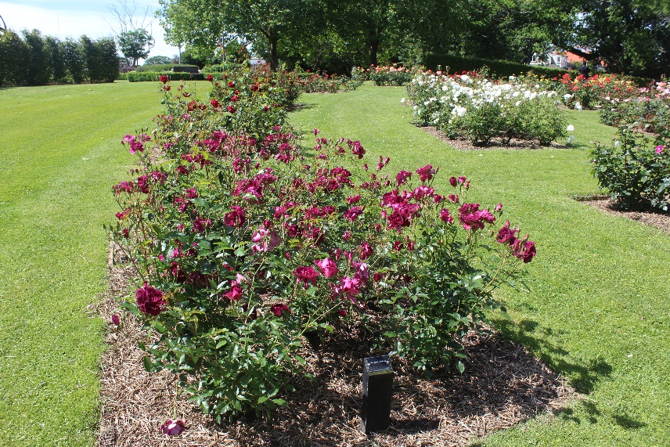
Rotoroa Lake Rose Garden Hamilton
Main Entrance
Aeteoroa.. McGredy
Hamilton Gardens
Burgundy Iceberg

Slide 16
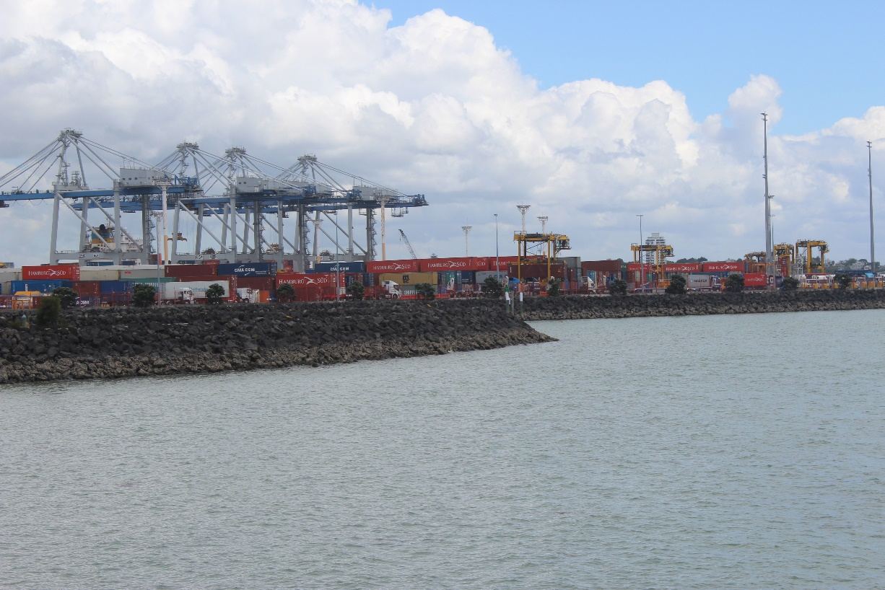

Auckland Port Normal Traffic

Slide 17




Auckland Museum

Slide 18


Maori Cultural at the Museum

Slide 19

Dove-Myer Robinson Park, more commonly known as the Parnell Rose Garden, is a park containing a rose garden in Parnell, Auckland, New Zealand..

Slide 20


Parnell Park is the host to the Parnell Festival of Roses.

Slide 21




More Favourites
Munstead Wood
Double Delight

Slide 22




Just a small sample
Fellowship
Pacific Glory

Slide 23




Great selection of New Zealand Roses
Nelson Girls
Raspberry Ice

Slide 24


Tony’s Weeds!!! Iceberg Standards, General View of the Park

Slide 25



On the Road to the Bay of Islands

Slide 26





Cape Brett Hole in the Rock Paihia

Slide 27






Otehei Bay and the Walk/Climb up the Hill

Slide 28



Enjoying Paihia, The Tree Top House at Bay of Islands..

Slide 29





Treaty of Waitangi Site and Meeting Place

Slide 30


Maori Long Boats

Slide 31




Haruru Falls Walk and Kayaking - Sues delight

Slide 32



Paihia to Whangarei

Slide 33


“Glitz & Glamour” National Spring Rose Show and Convention Hosted by the Northland Rose Society Forum North Whangarei

Slide 34




Whangerei National Rose Conference Staging

Slide 35



A selection of the roses at Whangarei

Slide 36






Sue gets jealous of these Single Blooms

Slide 37





Slide 38



Dancing at the National Rose Awards

Slide 39


Off to visit the local Gardens on the Sunday morning with a little rain present

Slide 40




Sheree’s Mums (Violet) house in Whangarei

Slide 41



New Zealand Northland home grown roses
Sexy Rexy
Wild Cherry
Sea Pearl

Slide 42


Overnight at Auckland then to Rotorua via Tauranga

Slide 43


Visiting Rob Somerfield’s Tauranga Nursery was Sues highlight of the New Zealand Trip

Slide 44






Rob’s Nursery: Look at the size of the nursery trial grounds

Slide 45






Some of Rob’s Pre-release Unnamed Roses

Slide 46




Rob says that rose bushes should be healthy first, healthy second and healthy third. Explains about thornless roses too. Extraordinary colours too.

Slide 47





Rob’s green rose SomPounamu

Slide 48


Rob picking up Medals at the NZ trials Palmerston North

Slide 49




Murray Linton Rose Garden Rotorua

Slide 50


My garden gnome at Rotorua Rose Garden

Slide 51


Rotorua to Taupo to Dannevirke
Rapids at Lake Taupo Outlet

Slide 52






Jads place at Dannevirke

Slide 53


Napier: Art Deco Capital of NZ

Slide 54





Along the Esplanade at Napier
Art Deco Centre
War Memorial Napier
In the Hotel

Slide 55



On to Palmerston North: Dugald MacKenzie Gardens, Site of the ‘Gold Star of the Pacific’ Trial Gardens NZ Rose Society International Rose Trials

Slide 56



Palmerston North.. Dugald Mackenzie Rose Garden

Slide 57




Hamilton Gardens
Roses in the Dugald Mackenzie Garden
Queen Wilhelmina

Slide 58




More Roses
Absolutely Fabulous
Blackberry Nip

Slide 59



In the Dugald McKenzie Gardens

Slide 60


Palmerston North Briefing and Judging Eileen Wilcox, Jan Barnett, Hayden Foulds

Slide 61



Floral Art at the Art Show Palmerston North

Slide 62






Twenty-five plus Clusters of roses – Roses we don’t see in Brisbane

Slide 63


Conventional Hybrid Tees

Slide 64


Trial Gardens: Tallying Up the Scores , the Final 2 year of Assessment –The Gardeners for the Trial Gardens

Slide 65



Slide 66


Rob Somerfield receives his medals

Slide 67



Leaving Wellington arriving Picton then to Nelson

Slide 68


Nelson at the Honest Lawyer Pub

Slide 69


Nelson Rose Garden

Slide 70






Nelson Rose Garden… Rose district

Slide 71



Old Botanic Garden in Nelson Isel Park

Slide 72



Cloudy Bay Winery

Slide 73



Into the mountains Nelson to Greymouth

Slide 74




Leaving Greymouth to Arthurs Pass

Slide 75



Arthurs Pass Greymouth to Christchurch

Slide 76



Arthurs Pass to Christchurch

Slide 77




Arthurs Pass to Christchurch through the clouds

Slide 78




Botanic Gardens in Christchurch

Slide 79


Central Rose Garden in Christchurch

Slide 80




More Roses
Waikato
Strawberry Ice

Slide 81


Central Rose Park listing of Roses Going overboard with details

Slide 82




Heritage Rose Garden Christchurch

Slide 83



Christchurch earthquake occurred in Feb 2011

Slide 84


Rebuilding the earthquake damaged Christchurch Cathedral

Slide 85



The turnoff to Shag Point along Christchurch Dunedin Rd

Slide 86




Species collection of the Timaru Botanic Gardens

Slide 87




Dunedin Botanic Garden

Slide 88



Dunedin Rose Garden one of the best
Kaikoura
Sky Tower

Slide 89



Dunedin Bay major port for South Island

Slide 90





Dunedin to Queenstown

Slide 91


The old Steam Boat from our hotel room

Slide 92

The Last Wine in New Zealand

